Slide 1
Computer Graphics - A Brief History & Intro
Dellie Wright and Dylan Kneidel

Slide 2
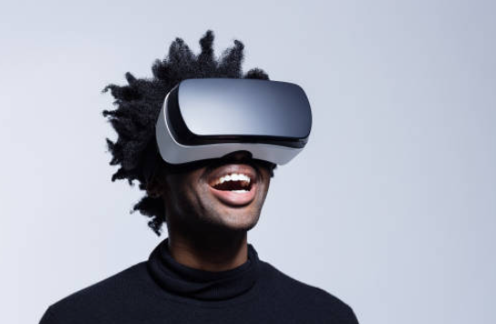
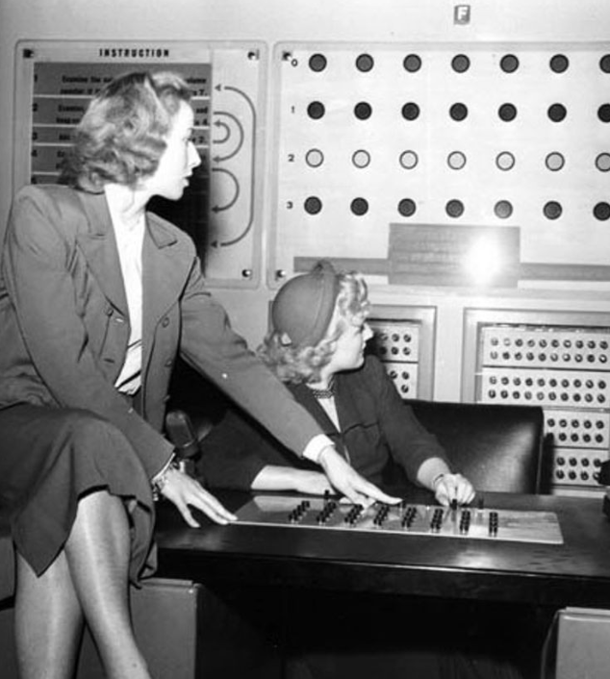
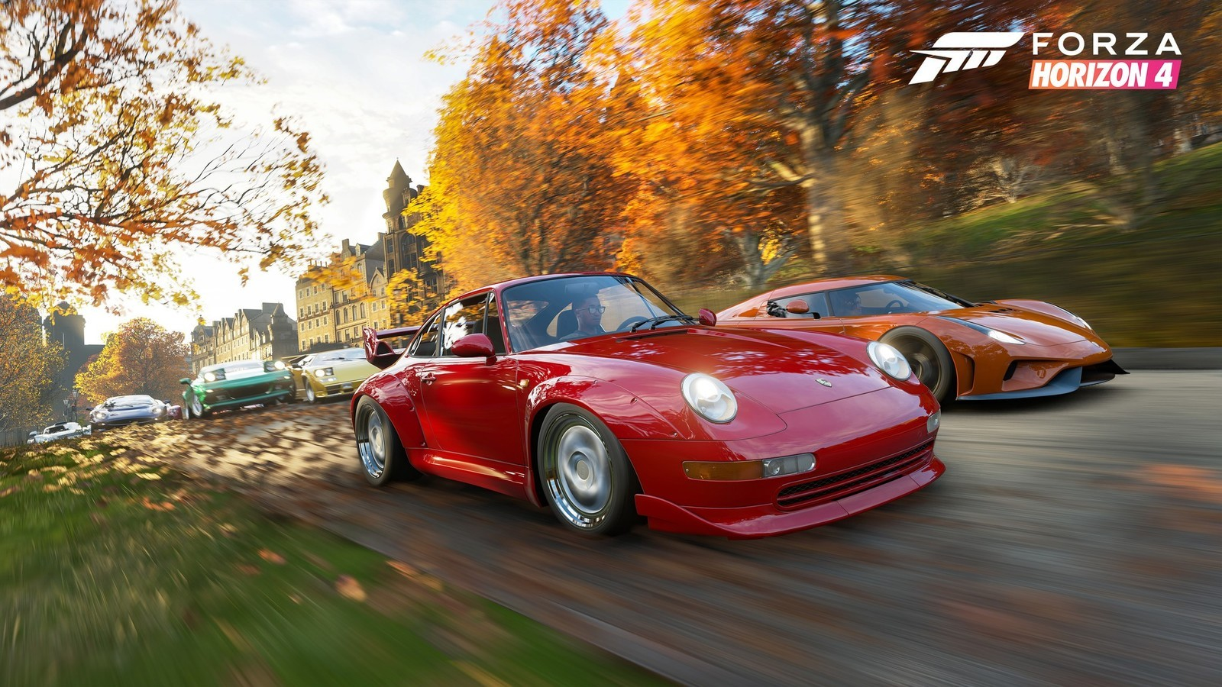
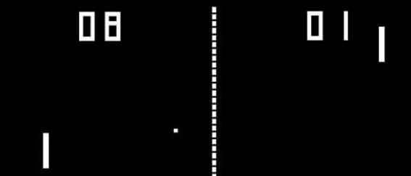
Our Agenda
from here…
to now!
Notes:
d3

Slide 3
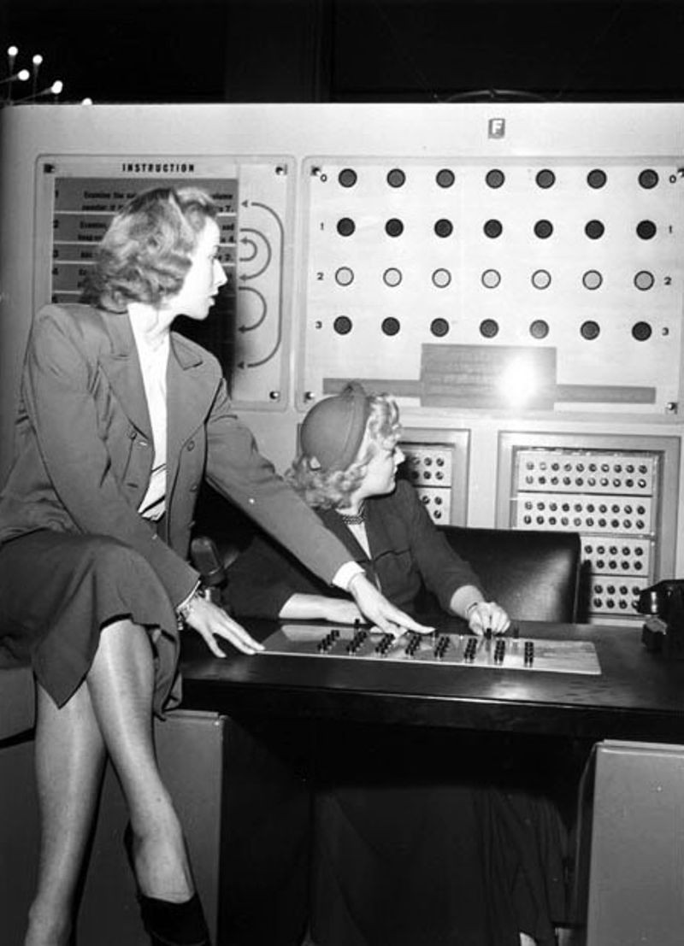
Nimrod - First Gaming Computer
Nimrod (1951)
Used for Nim!
This made it the first “gaming computer”
Put on display at the Festival of Britain
Another Nim device was displayed at the World’s Fair in 1939

Slide 4
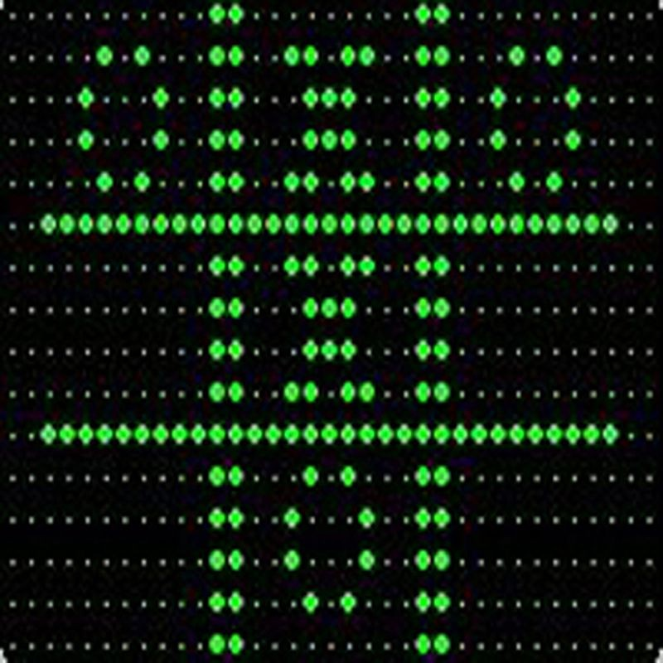
Tic Tac Toe at Cambridge
Cambridge Computer (1952)
Tic-Tac-Toe game, named OXO
Used a rotary telephone dial to enter moves
Display was a 35x15 dot cathode ray tube!
Notes:
d3

Slide 5
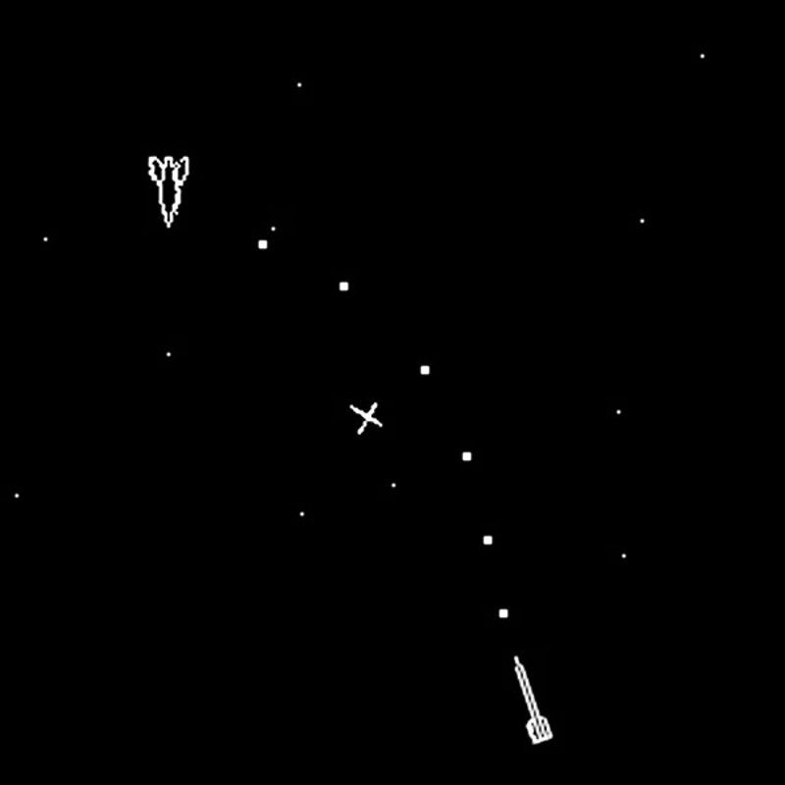
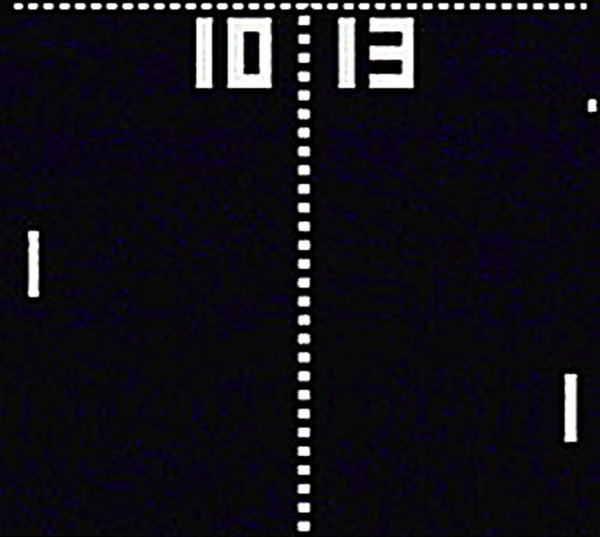
(1962 - 1972)
SpaceWar!
Pong
Made by MIT!
“Expensive Planetarium” made the background
Initially tested in CA bars?
Same year C was created!
Notes:
d3

Slide 6

1957-1969
Programming Languages
UNIX & Internet
Allowed games to be shared and developed more easily.
Basic, C, Fortran, COBOL made development easier and more accessible.
Notes:
dk8

Slide 7
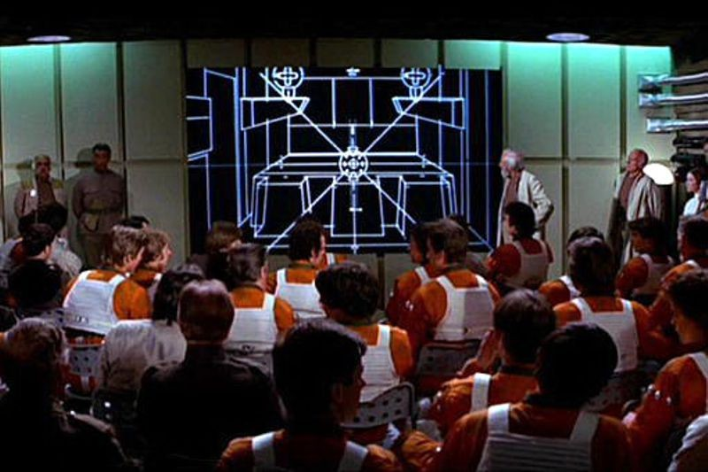
1970s - The rise of CG
Magnavox Odyssey (1972)
First home console
Introduced cartridge-based games
Xerox PARC Alto (1974)
Windows, icons, mouse, and GUI-based!
Inspired the Macintosh
Death Star Briefing (1977)
One of the first uses of wireframe animation in film
Home game devs 1979s
Handheld games - 1980 first nintendo console
arcade golden age - 1978-1982
Notes:
d3

Slide 8
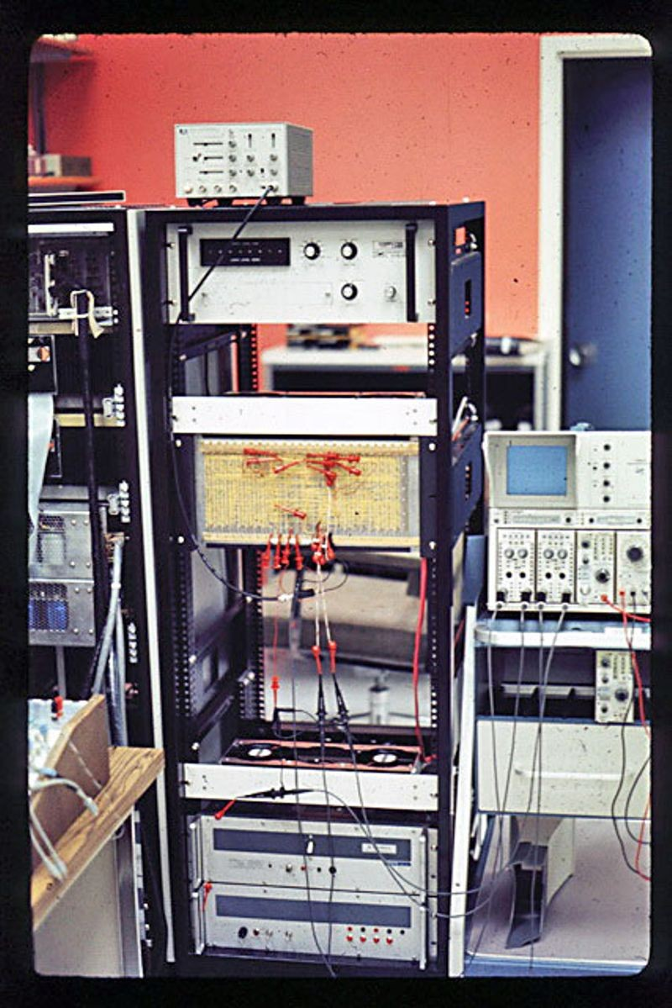
Super Paint (1972)
First digital computer system to use a frame buffer
Grandparent to modern paint programs!
Adjustable paintbrushes
Animation creation
24-bit color
Notes:
dk8

Slide 9
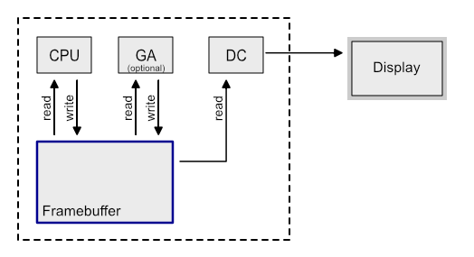
What is a Frame Buffer?
These are a crucial part of rendering graphics using computers.
Frame Buffer - A portion of memory temporarily used to store frame data, driving video display.
Consists of color values for each pixel on a screen to display
Modern video cards use frame buffer circuitry
Many GPUs render from 1-3 frames ahead now!
DC - Display Controller
hardware that drives and refreshes display
Notes:
d3

Slide 10
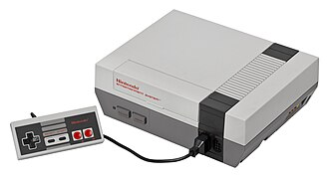
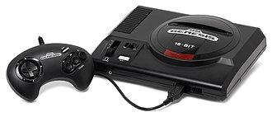
1980s - Explosion of Computing
In the 80s, technological revolution made CPUs, GPUs, and Personal Computers widely available.
This allowed commercial use of these tools to skyrocket:
Lucasfilm’s use of Computer Graphics
This took two computers, two frame buffers, and two man-years of work
Pixar formed - 1982
Mario, Metroid, Duck Hunt, Punch-out, Contra, Donkey Kong, The Legend of Zelda, Castlevania
Third & 4th Generation Consoles
Notes:
d3

Slide 11

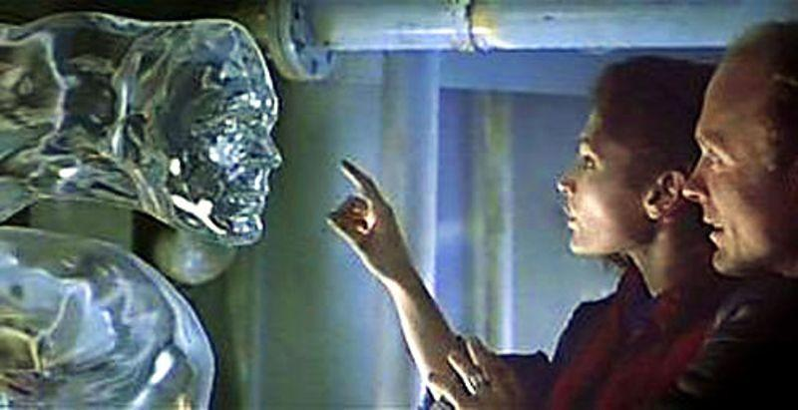
1987 - Photoshop Pitstop
You should recognize this one…
Invented by Thomas and John Knoll, then sold to Adobe
Raster graphics editor
Used to be called “Display” !?
Used in 1989’s The Abyss to make the alien shown below
Helped win best SFX in 1990!
Commercially released in 1990 exclusively for the Macintosh
Notes:
dk8

Slide 12
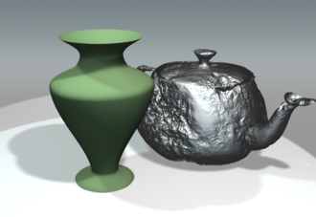
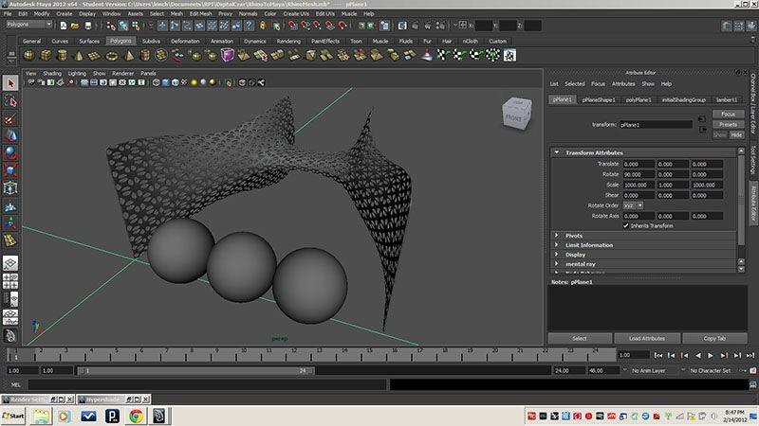
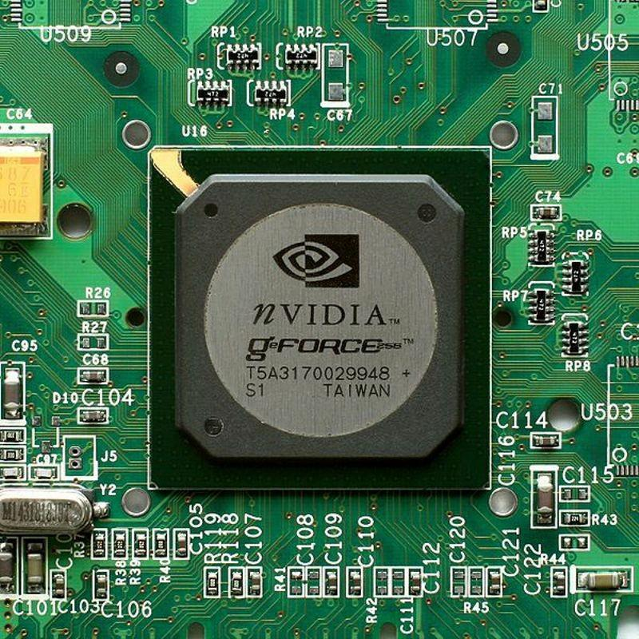
1990s - The Rise of 3d Graphics
Pixar was formed, releasing its first film, Toy Story (1995)
They also got a patent for their point sampling techniques! (right)
Used in the 80’s before then
Aka Reyes rendering, divides curved surfaces into micropolygons
Silicon Graphics Incorporated (SGI) released Maya (bottom right)
Used in both animation and games
JPEG Standard got finalized! (1992)
First “GPU” in NVIDIA’s GeForce 256 (1999)
Notes:
d3

Slide 13
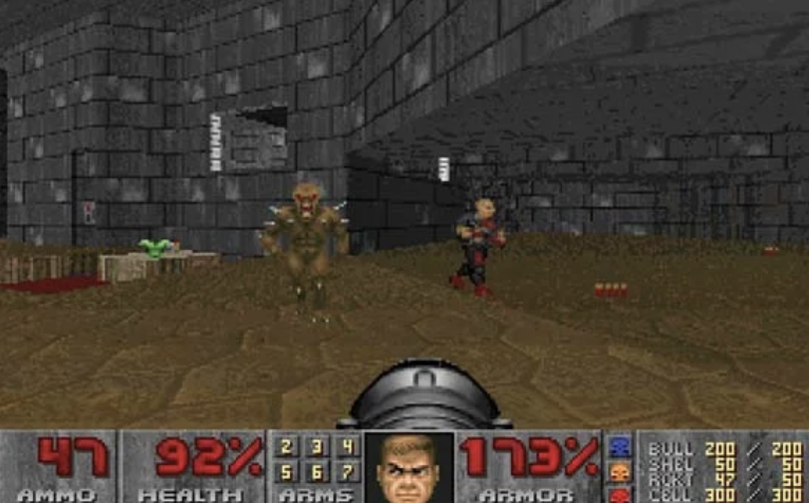
1990s - Video Games
Wolfenstein 3D (1992)
Although Doom is more popular, Wolfenstein 3D is the father of the modern FPS
Doom (1993)
Most Iconic FPS of the 90s
controversially violent
One of the first games where modding was possible
Incredible realism and immersion for its time
Quake (1996)
Popular due to its speed, online, and fully 3d nature
The first fully-online 3D FPS
Half-Life (1998)
Couldn’t talk about revolutionary video games w/o Half-Life
First application of storytelling through games
Notes:
d3

Slide 14

2000S - Video Games & CGI
More growth from previous generations!
Familiar games:
Counter Strike, FF7, Half-life 2, Portal, Metal Gear Solid 2, Resident Evil 4, Call of Duty, Assassins Creed,
Open world 3d gameplay, First Person Shooters, Online Games
CGI and Movies!
Ice Age, Madagascar, Finding Nemo, Cloudy with a chance of meatballs
Real explosion of Animated Movies
The Polar Express….
On the backend…
OpenGL, NVIDIA/AMD 3D GPUs, DirectX, etc.
Notes:
dk8

Slide 15
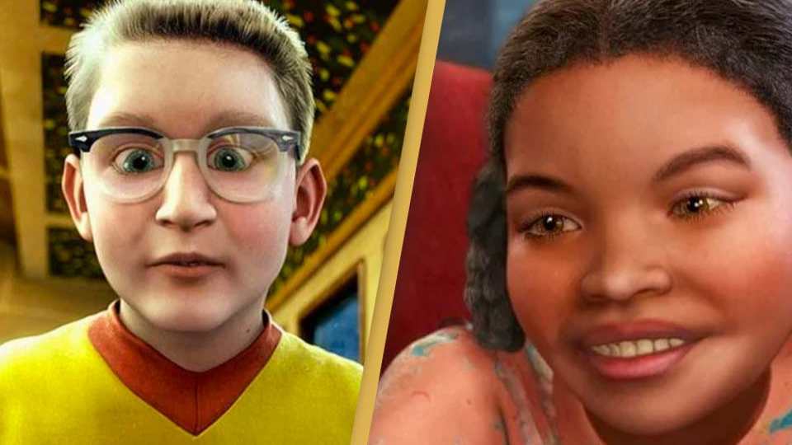
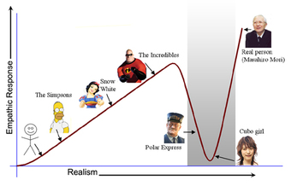
Side Note - Uncanny Valley
The 2000s was when we first discovered the idea of uncanny valley
This was the first time computer graphics were good enough to remotely resemble humans
Notes:
d3

Slide 16

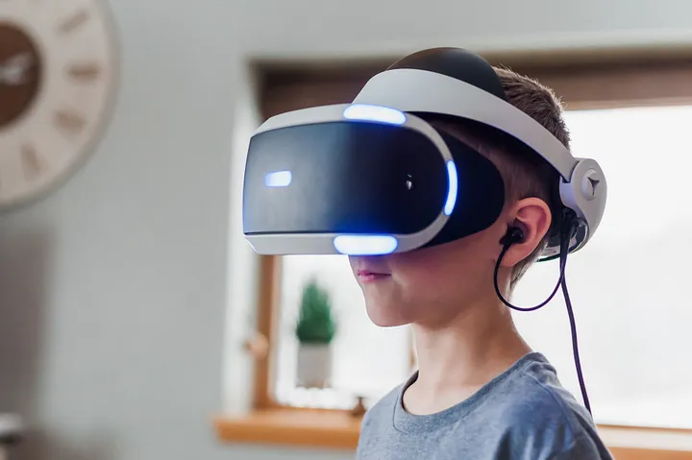

Catching Up…
Recent Improvements
Ray Tracing
Photo Realism
Augmented Reality
Virtual Reality
AI Technology

Slide 17


Python Applications! - Getting Started
Python Turtle
A simple graphics library for drawing
Uses a “turtle” (a little robot with a pen) that draws on screen
Pygame
A more advanced python library for game development

Slide 18
Getting Started
- Pong! & Pygame!
In this week’s section on github, you will find .py file called pong.py,
You can copy that file and run the code to start playing with python turtle.
In this week’s section on github, you will find a .py file called pygameEx.py
You can check that file out and use it as a starting guide for using pygame.

Slide 19
Blooket Time!

